Slide 1

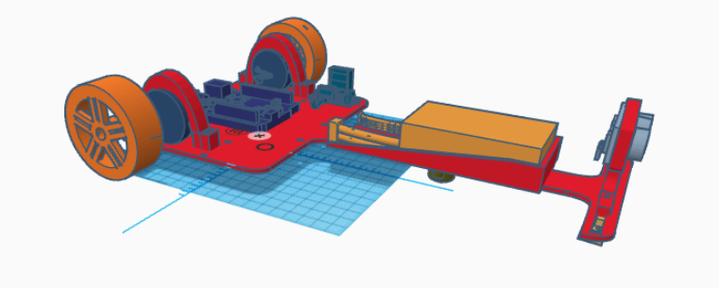
Presentation for Line follower Vehicle
BS.c Electronics Engineering
Hochschule Hamm-Lippstadt
Electronics Engineering Department
Line follower Vehicle Prototyping and System Engineering
By:
Abdallattif khaled
Bs.c Student, Electronics Engineering Department, at Hochschule Hamm-Lippstadt, Lippstadt , Germany.
Under the supervision of:
Prof. Stefan Henkler

Slide 2
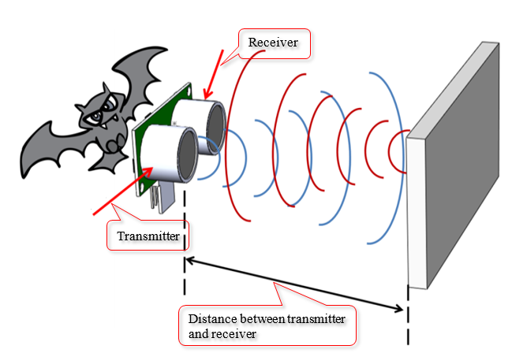
Agenda :
Overview
Sys-ML
Design
Hardware Component
Software & Code
Results and Discussion

Slide 3
Sys ML
Design
Hardware Component
Software & Code
Results and Discussion
Overview
It is an Line follower vehicle which can follow the line on the ground using IR- Sensor with motor controller.
It can detect the line and adjust its speed and direction accordingly.
The system can also avoid obstacles and stop at any given destination by using Ultrasonic sensor besides avoid the obstacle to follow the line again.
System Specification

Slide 4
SysML
Design
Hardware Component
Software & Code
Results and Discussion
Overview
System Specifications: # Requirements
The vehicle must be able to follow the lines on the ground using IR sensor, and a motor controller with its driver to allow the speed control. - The vehicle must be able to avoid obstacles and stop by ultra sonic sensor at any given destination and ignore it by using the code.
- The vehicle must be able to operate on battery power for at least 30 minutes.
# Components
- The vehicle consists of the following components:
- A chassis with two wheels and a differential drive mechanism.
- IR sensors mounted on the front of the chassis that can catch the line and follow it successfully.

Slide 5
SysML
Design
Hardware Component
Software & Code
Results and Discussion
Overview
System Specifications: - A motor controller with its driver that can control the speed and direction of the wheels based on the input from the IR-Sensors and.
- A microcontroller or Arduino that can process IR-Sensors Ultrasonic to send commands to the motor controller.
- A battery pack that can provide power to the Microcontroller/ Arduino, the motor controller, and the camera. - 2 wheels and On/Off Button.

Slide 6
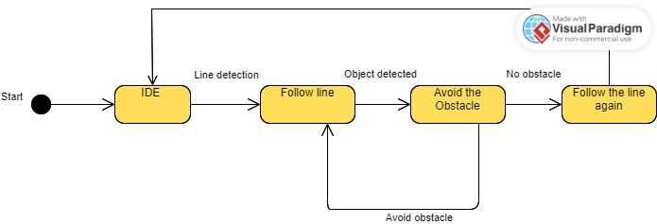
Background
Design
Hardware Component
Software & Code
Results and Discussion
Sys-ML
State machine Diagram

Slide 7
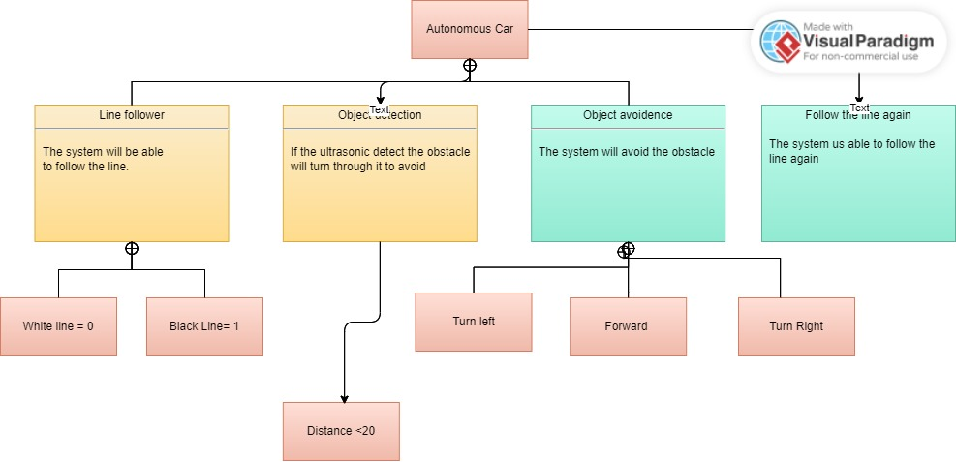
Overview
Design
Hardware Component
Software & Code
Results and Discussion
Sys-ML
Requirement Diagram

Slide 8
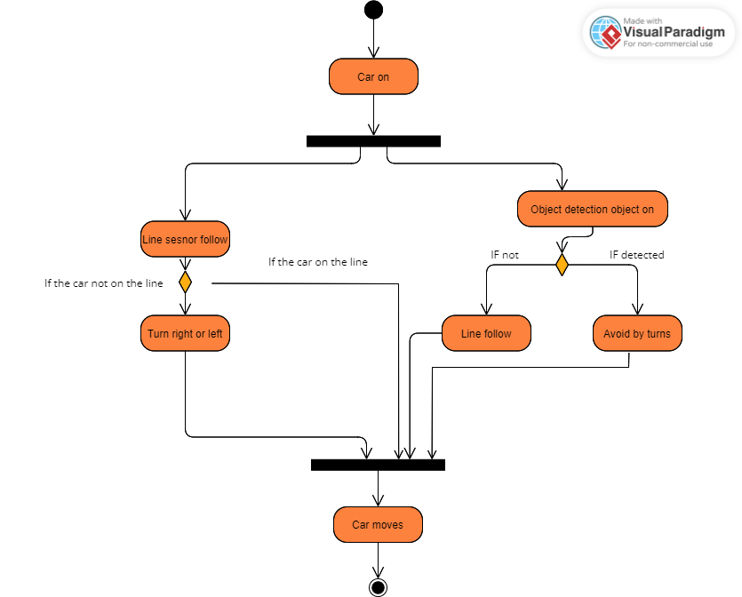
Overview
Design
Hardware Component
Software & Code
Results and Discussion
Sys-ML
Basic Activity Diagram

Slide 9
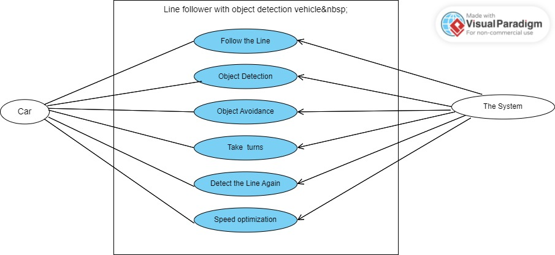
Overview
Design
Hardware Component
Software & Code
Results and Discussion
Sys-ML
User Case Diagram

Slide 10
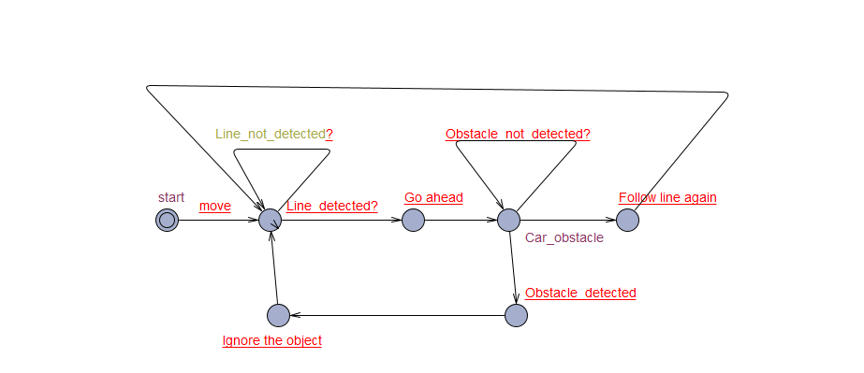
Background
Design
Hardware Component
Software & Code
Results and Discussion
Sys-ML
Uppaal Diagram

Slide 11
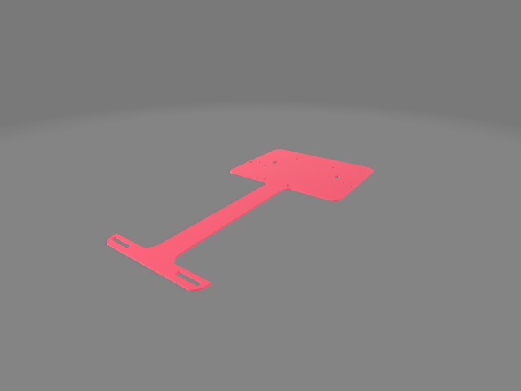
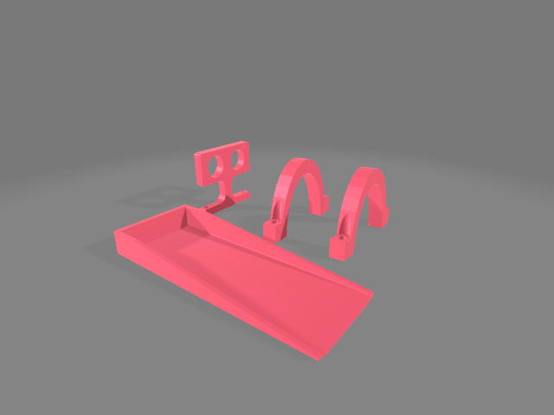
Overview
Sys-ML
Hardware Component
Software & Code
Results and Discussion
Design
Preliminary Design

Slide 12
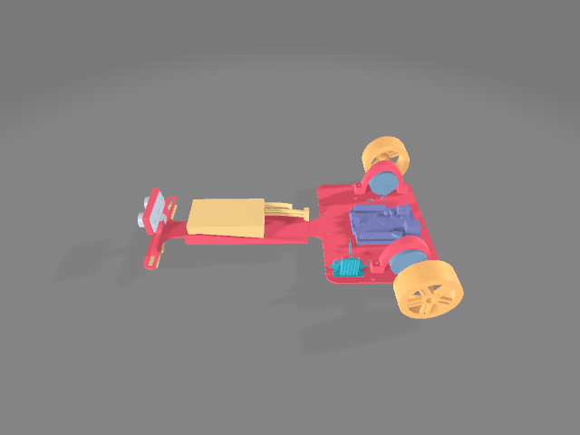
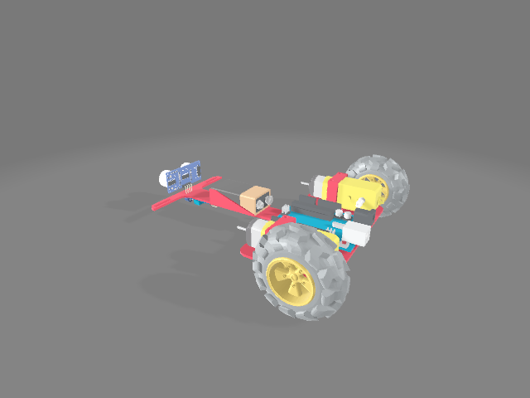
Overview
Sys-ML
Hardware Component
Software & Code
Results and Discussion
Design
Final Design

Slide 13
Overview
Sys-ML
Hardware Component
Software & Code
Results and Discussion
Design
Final Design

Slide 14
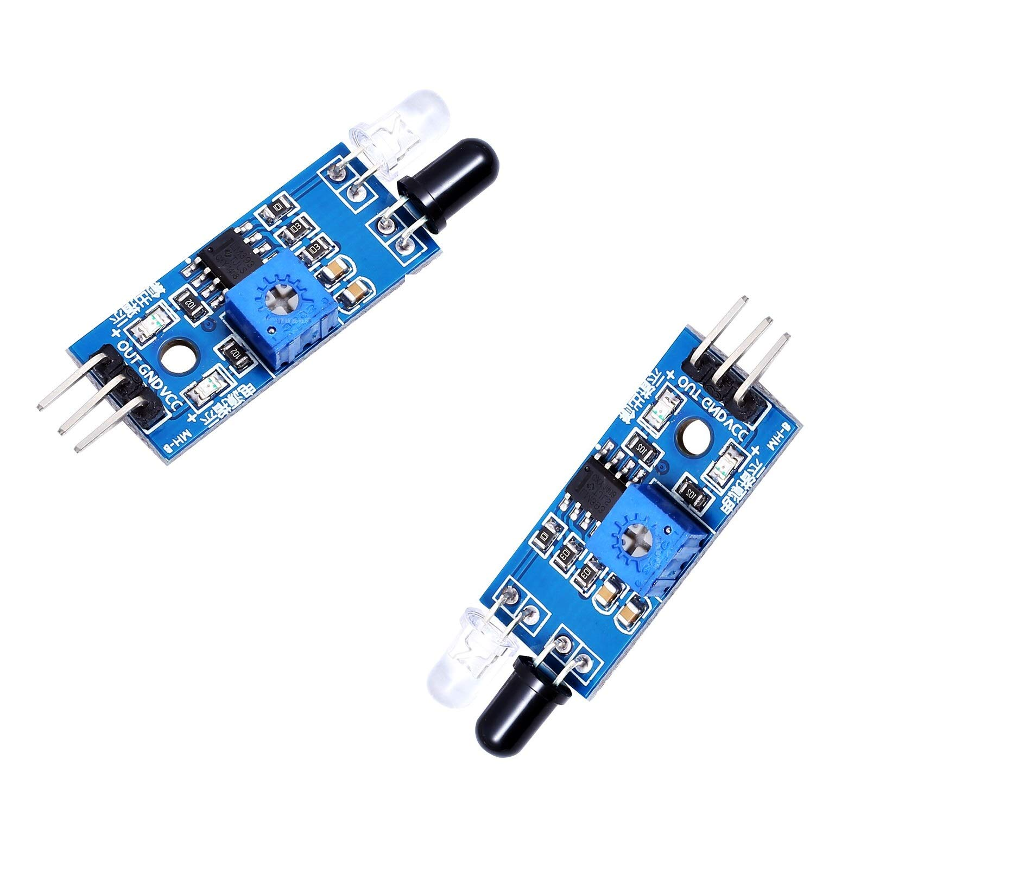
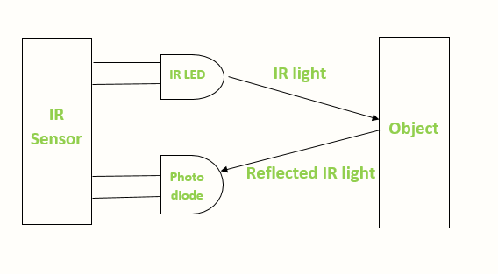
Overview
Sys-ML
Design
Software & Code
Results and Discussion
Hardware Component
2- IR-Sensor
Active infrared sensors work with radar technology and they both emit and receive infrared radiation. This radiation hits the objects nearby and bounces back to the receiver of the device.

Slide 15
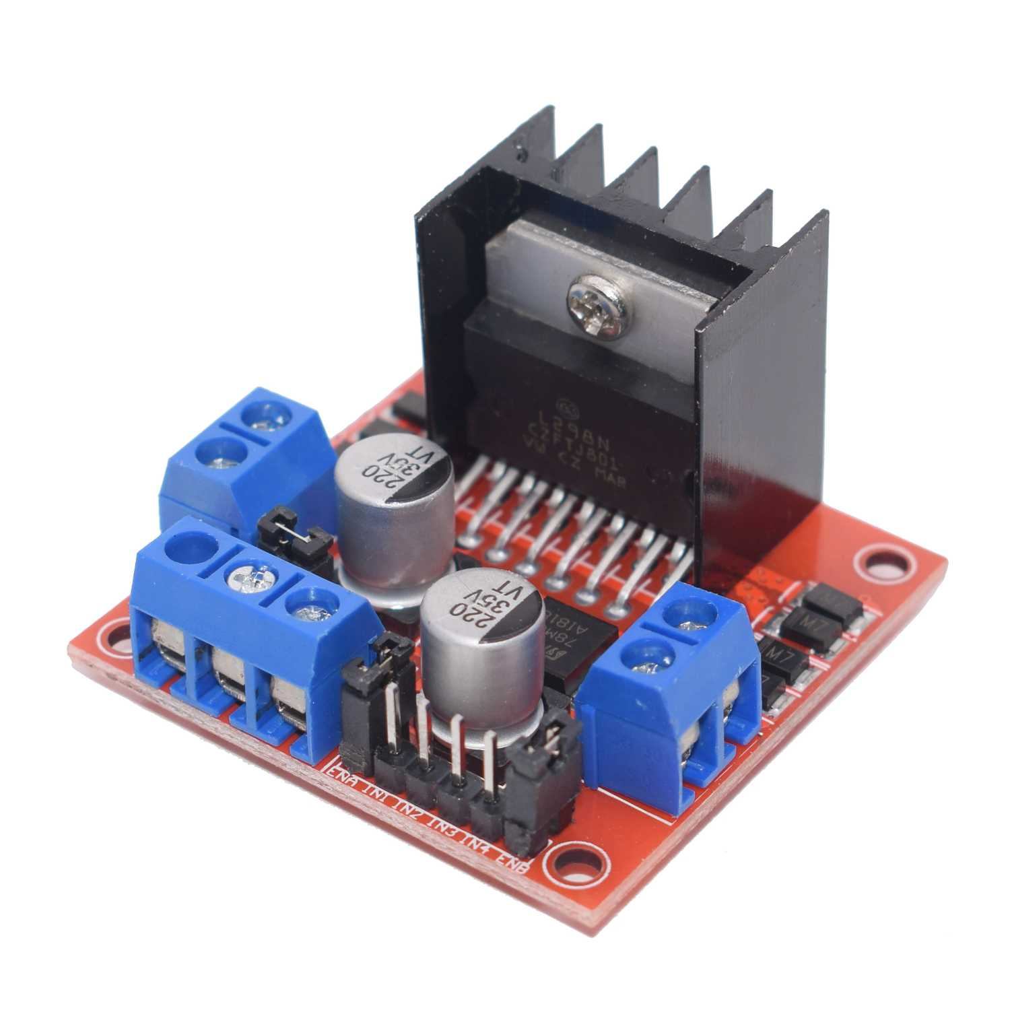
Overview
Sys-ML
Design
Software & Code
Results and Discussion
Hardware Component
Motor Driver Controller Board
-It is an electrical or electronic devices that regulate motor speed, torque, and position outputs. The drive modifies the power input to the motor to achieve the desired output. -The controller circuits are commonly integrated with the drive circuits as one stand-alone unit, thus the terms motor drive and motor controller are frequently used interchangeably

Slide 16
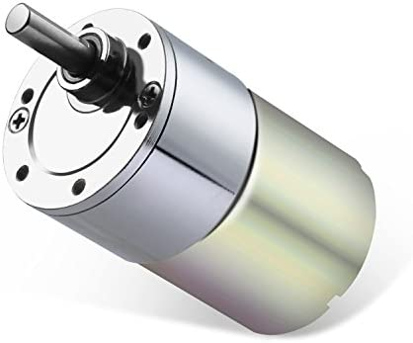
Overview
Sys-ML
Design
Software & Code
Results and Discussion
Hardware Component
DC- Motor
DC 12 V 100 RPM Gear Motor High Torque Electric Micro Speed, You also can adjust the speed, but the motor speed can only be reduced, can not be raised. Low noise and high torque, such as 10rpm can drive 15 kilograms.

Slide 17
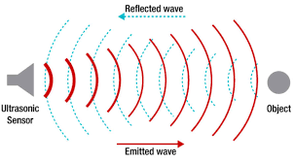
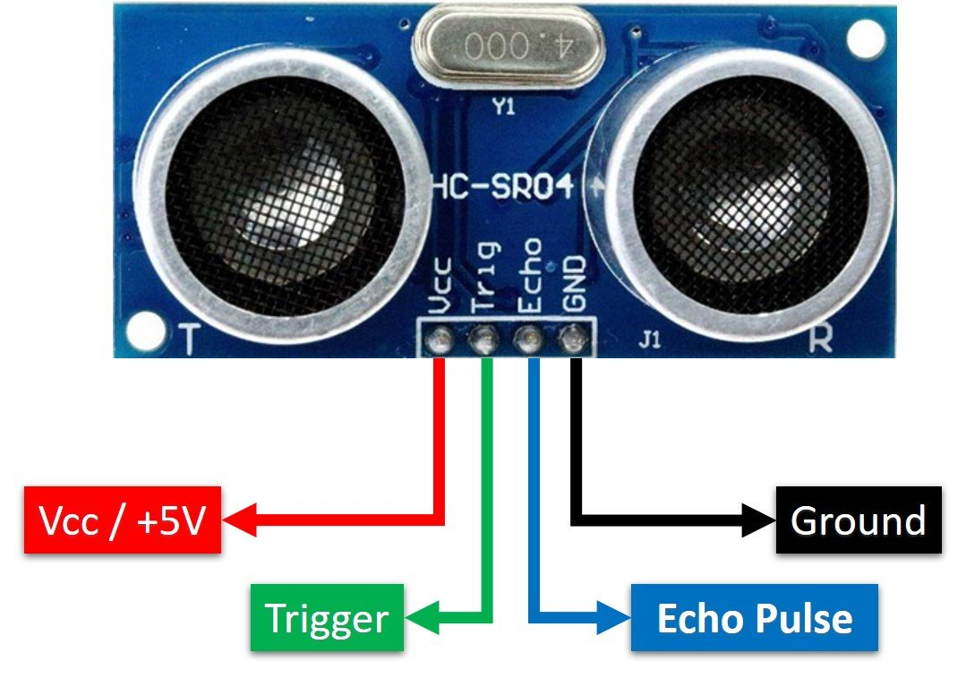
Overview
Sys-ML
Design
Software & Code
Results and Discussion
Hardware Component
Ultrasonic Sensor
An ultrasonic sensor emits a sound pulse in the ultrasonic range. This sound pulse propagates at the speed of sound through air (about 344 meters per second) until the sound pulse encounters an object. The sound pulse bounces off the object and is returned in reverse to the sensor where this "echo" is received..

Slide 18
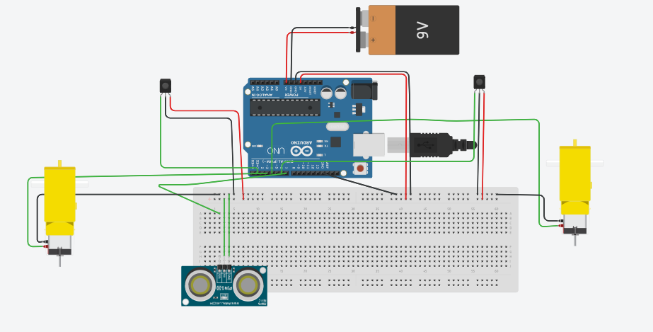
Overview
Sys-ML
Design
Software & Code
Results and Discussion
Hardware Component
Simulation_1

Slide 19
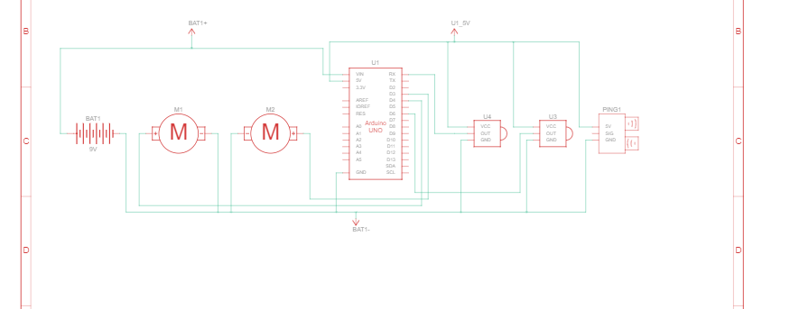
Overview
Sys-ML
Design
Software & Code
Results and Discussion
Hardware Component
Simulation_2

Slide 20

Overview
Sys-ML
Design
Hardware Component
Results and Discussion
Software & Code
$$ρ$$
Initialization & Declaration
//Ultasonic Intialization//motors
#define input1 13
#define input2 12
#define input3 7
#define input4 6
#define enA 11
#define enB 5
int LEFT_SENSOR;
int RIGHT_SENSOR;
#define echo 8 //Echo pin
#define trigger 9 //Trigger pin
//ir sensors
#define LirSensor 3
#define RirSensor 4
int maxSpeed = 95; //100
int turnSpeed = 75;
int duration;
int distance;
//Pin Intialization void setup() {
Serial.begin(9600); pinMode(echo, INPUT);
pinMode(trigger, OUTPUT);
pinMode(enA, OUTPUT);
pinMode(enB, OUTPUT); pinMode(motoright, OUTPUT);
pinMode(motoleft, OUTPUT);
pinMode(motoright OUTPUT);
pinMode(motoleft, OUTPUT);
pinMode(LirSensor, INPUT);
pinMode(RirSensor, INPUT);
}

Slide 21
Overview
Sys-ML
Design
Hardware Component
Results and Discussion
Software & Code
$$ρ$$
Implementation_1
void loop() {
// Clears the trigPin
digitalWrite(trigger, LOW);
delayMicroseconds(2);
// Sets the trigPin on HIGH state for 10 micro seconds
digitalWrite(trigger, HIGH);
delayMicroseconds(10);
digitalWrite(trigger, LOW);
// Reads the echoPin, returns the sound wave travel time in microseconds
duration = pulseIn(echo, HIGH);
// Calculating the distance
distance = duration * 0.034 / 2;
//for Line follow
int LEFT_SENSOR = digitalRead(LirSensor);
int RIGHT_SENSOR = digitalRead(RirSensor);
Serial.print("leftsenor: ");
Serial.print(LEFT_SENSOR);
Serial.print(" ");
Serial.print("RIghtsenor: ");
Serial.print(RIGHT_SENSOR);
if (RIGHT_SENSOR == 0 && LEFT_SENSOR == 0) { // 1 =black, 0= white
forward(); //FORWARD
}
else if (RIGHT_SENSOR == 1 && LEFT_SENSOR == 0) {
right(); //Move Right
}
else if (RIGHT_SENSOR == 0 && LEFT_SENSOR == 1) {
left(); //Move Left
}
else if (RIGHT_SENSOR == 1 && LEFT_SENSOR == 1) {
}
avoidobject();
}
void forward()
{
digitalWrite(input1, HIGH);
digitalWrite(input2, LOW);
digitalWrite(input3, HIGH);
digitalWrite(input4, LOW);
analogWrite(enA,maxSpeed);
analogWrite(enB, 130);
}

Slide 22
Background
Sys-ML
Design
Hardware Component
Results and Discussion
Software & Code
$$ρ$$
void avoidobject(){
if (distance<20) {
left();
delay(700);
forward();
delay(1700);
right();
delay(1400);
forward();
while(LEFT_SENSOR == 0){
LEFT_SENSOR = digitalRead(LirSensor);
}
Stop();
delay(750);
forward();
delay(500);
Stop();
delay(750);
left();
delay(900)
Implementation_2
void right()
{
digitalWrite(input1, LOW);
digitalWrite(input2, HIGH);
digitalWrite(input3, HIGH);
digitalWrite(input4, LOW);
analogWrite(enA, turnSpeed);
analogWrite(enB, 105);
}
void left()
{
digitalWrite(input1, HIGH);
digitalWrite(input2, LOW);
digitalWrite(input3, LOW);
digitalWrite(input4, HIGH);
analogWrite(enA, turnSpeed);
analogWrite(enB, 105);
}
void Stop()
{
digitalWrite(input1, LOW);
digitalWrite(input2, LOW);
digitalWrite(input3, LOW);
digitalWrite(input4, LOW);
}

Slide 23
Background
Literature review
Problem Statement
Aim and Objectives
Research Methodology
Results and Discussion
The line follower vehicle can track the line successfully by using 2- IR Sensor.
The ultra-sonic Sensor can detect the object by distance 25 CM.
The vehicle can Avoid the object by 3 movements.
The vehicle can catch the line the follow it again according to some steps.
The maximum speed is 100 and turning speed is 75 according to the code.
The calibration of motor in terms of Forward function is 130 as EnB, EnA Right & Left Function is 105. https://github.com/Dapsara96/prototyping

Slide 24
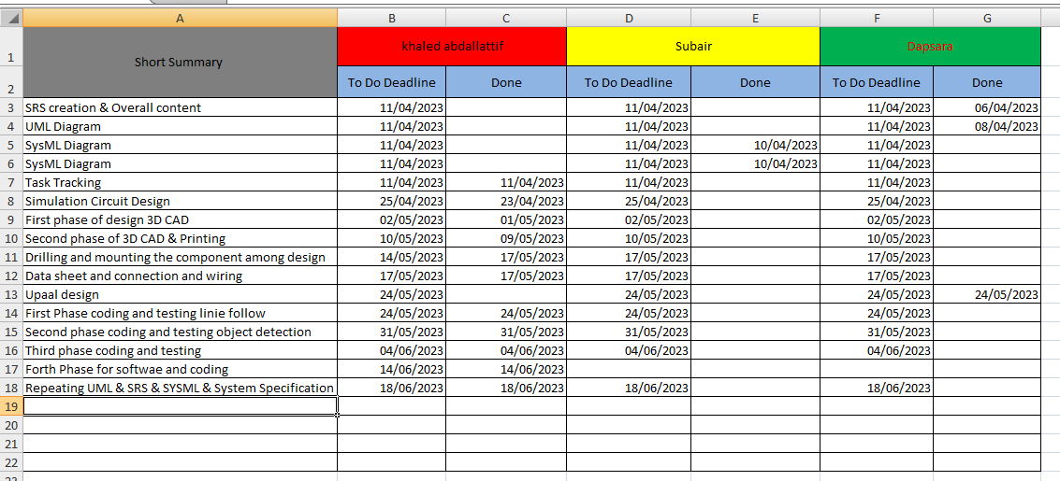
Background
Literature review
Problem Statement
Aim and Objectives
Research Methodology
Results and Discussion
https://github.com/Dapsara96/prototyping

Slide 25
Thank You Questions?

